Slide 1

Data Parallelism
Companion slides for
The Art of Multiprocessor Programming
by Maurice Herlihy, Nir Shavit, Victor Luchangco, and Michael Spear
TexPoint fonts used in EMF.
Read the TexPoint manual before you delete this box.: AAAA
Notes:
1

Slide 2
Ever Wonder …
When did the term multicore become popular?
A multi-core processor is a single computing component with two or more independent actual central processing units, which are the units that read and execute program instructions.)
wikipedia

Slide 3
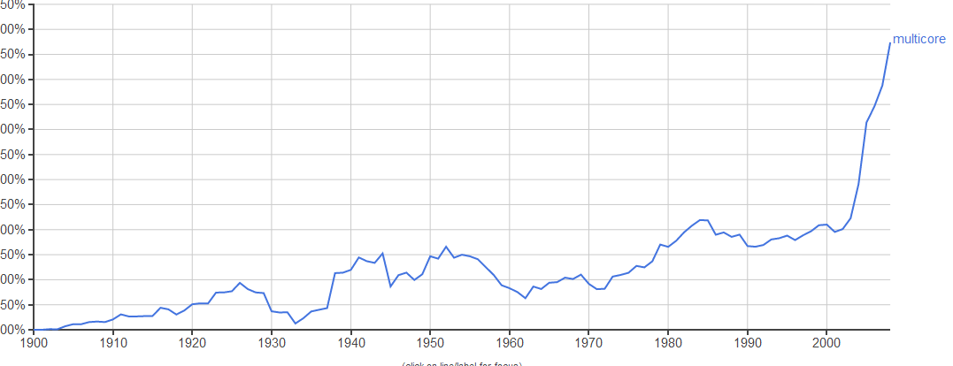
Let’s Ask Google Ngram!
usage of multicore in books by publication year

Slide 4
Let’s Ask Google Ngram!
This part since 2000 is obvious …

Slide 5
Let’s Ask Google Ngram!
???

Slide 6
Let’s Ask Google Ngram!
multicore cable
multicore fiber
…
but we digress …

Slide 7
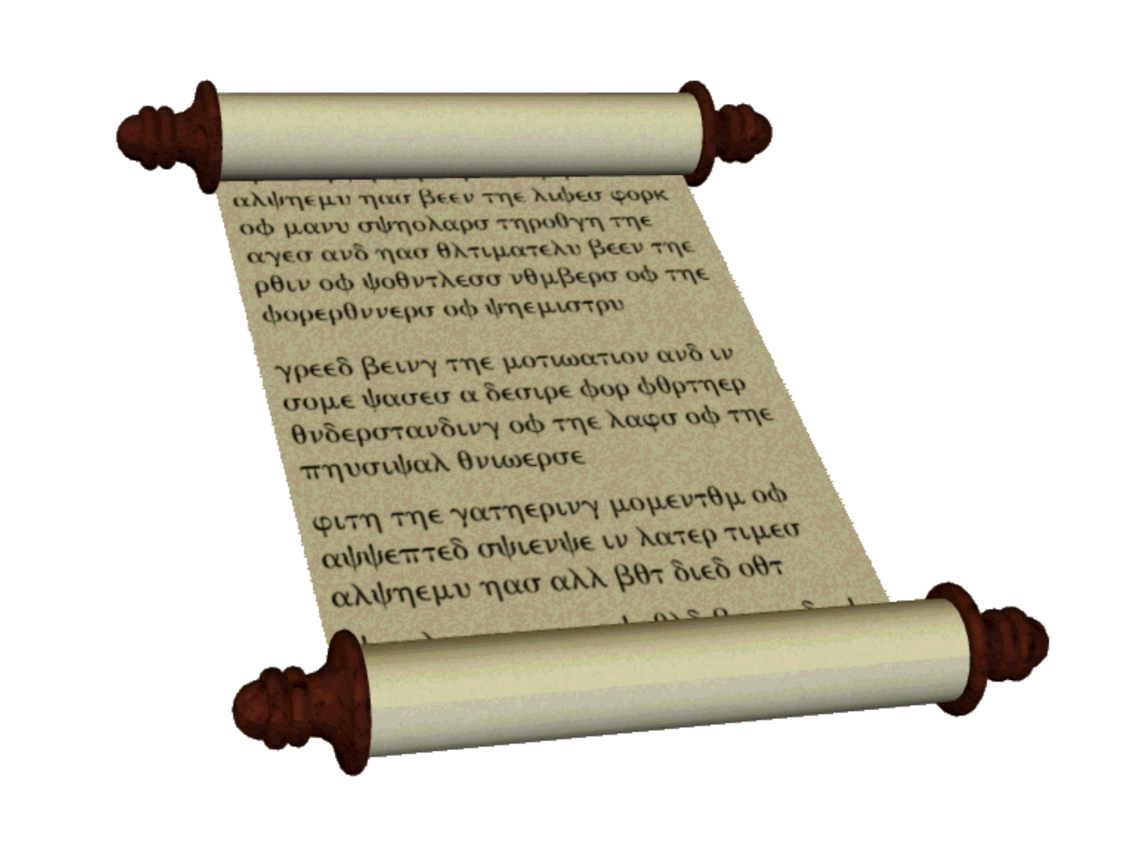
WordCount
alpha → 8
bravo → 3
charlie → 9
…
zulu → 1
easy to do sequentially …
what about in parallel?

Slide 8
MapReduce
split text among mapping threads
…
chapter 1
chapter 2
chapter k

Slide 9
Map Phase
must count words!
must count words!
must count words!
a mapping thread per chapter
…
chapter 1
chapter 2
chapter k

Slide 10
Map Phase
alpha → 9
juliet → 2,
alpha → 1
tango → 4
…
each mapper thread produces a stream …
of key-value pairs …
key: word
value: local count
chapter 1

Slide 11
Mapper Class
abstract class Mapper<IN, K, V>
extends RecursiveTask<Map<K, V>> {
IN input;
public void setInput(IN anInput) {
input = anInput;
}
}
Notes:
Mappers inherit from the abstract Mapper class shown here

Slide 12
Mapper Class
abstract class Mapper<IN, K, V>
extends RecursiveTask<Map<K, V>> {
IN input;
public void setInput(IN anInput) {
input = anInput;
}
}
input: document fragment
Notes:
The first parameter type is the input: in this case, the document fragment to be counted.

Slide 13
Mapper Class
abstract class Mapper<IN, K, V>
extends RecursiveTask<Map<K, V>> {
IN input;
public void setInput(IN anInput) {
input = anInput;
}
}
key: individual word
Notes:
The mapper extractss a sequence of keys from the input: in this case, individual words.

Slide 14
Mapper Class
abstract class Mapper<IN, K, V>
extends RecursiveTask<Map<K, V>> {
IN input;
public void setInput(IN anInput) {
input = anInput;
}
}
value: local count
Notes:
In Java, these methods should be used in the following structured way.
mutex.lock();
try {
... // body
} finally {
mutex.unlock();
}

Slide 15
Mapper Class
abstract class Mapper<IN, K, V>
extends RecursiveTask<Map<K, V>> {
IN input;
public void setInput(IN anInput) {
input = anInput;
}
}
a task that runs in parallel with other tasks
Notes:
Mapper inherits from RecursiveTask, which just means it is a task that runs in parallel with other tasks.

Slide 16
Mapper Class
abstract class Mapper<IN, K, V>
extends RecursiveTask<Map<K, V>> {
IN input;
public void setInput(IN anInput) {
input = anInput;
}
}
produces a map: word → count
Notes:
In Java, these methods should be used in the following structured way.
mutex.lock();
try {
... // body
} finally {
mutex.unlock();
}

Slide 17
Mapper Class
abstract class Mapper<IN, K, V>
extends RecursiveTask<Map<K, V>> {
IN input;
public void setInput(IN anInput) {
input = anInput;
}
}
initialize input: which document fragment?
Notes:
Each mapper must be given its own input.

Slide 18
WordCount Mapper
class WordCountMapper extends
mapreduce.Mapper<
List<String>, String, Long
> {
…
}
Notes:
For WordCount, we instantiate each parameter type as follows.

Slide 19
WordCount Mapper
class WordCountMapper extends
mapreduce.Mapper<
List<String>, String, Long
> {
…
}
document fragment is list of words
Notes:
The input document fragment is presented as a list of words

Slide 20
WordCount Mapper
class WordCountMapper extends
mapreduce.Mapper<
List<String>, String, Long
> {
…
}
document fragment is list of words
map each word …
Notes:
The output is a map where each key is a word found in the document fragment

Slide 21
WordCount Mapper
class WordCountMapper extends
mapreduce.Mapper<
List<String>, String, Long
> {
…
}
document fragment is list of words
map each word …
to its count in the fragment
Notes:
Each word in the document fragment is mapped to its count in the fragment (here, a long integer).

Slide 22
WordCount Mapper
Map<String,Long> compute() {
Map<String,Long> map = new HashMap<>();
for (String word : input) {
map.merge(word,
1L,
(x, y) -> x + y);
}
return map;
}
}
Notes:
In a RecursiveTask, the compute() method does all the work.

Slide 23
WordCount Mapper
Map<String,Long> compute() {
Map<String,Long> map = new HashMap<>();
for (String word : input) {
map.merge(word,
1L,
(x, y) -> x + y);
}
return map;
}
}
the compute() method constructs the local word count
Notes:
The compute() method creates, fills in, and returns the map holding the local word count.

Slide 24
WordCount Mapper
Map<String,Long> compute() {
Map<String,Long> map = new HashMap<>();
for (String word : input) {
map.merge(word,
1L,
(x, y) -> x + y);
}
return map;
}
}
create a map to hold the output
Notes:
Create an empty map from String to Long

Slide 25
WordCount Mapper
Map<String,Long> compute() {
Map<String,Long> map = new HashMap<>();
for (String word : input) {
map.merge(word,
1L,
(x, y) -> x + y);
}
return map;
}
}
examine each word in the document fragment
Notes:
Iterate over each word in the input list of strings

Slide 26
WordCount Mapper
Map<String,Long> compute() {
Map<String,Long> map = new HashMap<>();
for (String word : input) {
map.merge(word,
1L,
(x, y) -> x + y);
}
return map;
}
}
increment that word’s count in the map
Notes:
Increment each word’s count in the map. (Never mind the arcane Java syntax here.)

Slide 27
WordCount Mapper
Map<String,Long> compute() {
Map<String,Long> map = new HashMap<>();
for (String word : input) {
map.merge(word,
1L,
(x, y) -> x + y);
}
return map;
}
}
when the local count is complete, return the map
Notes:
Increment each word’s count in the map. (Never mind the arcane Java syntax here.)

Slide 28
Reduce Phase
alpha → 4
bravo → 2
…
zulu → 1
a reducer thread merges mapper outputs
alpha → 1
foxtrot → 1
papa→ 1
tango → 1
…
alpha → 2
juliet → 1
tango → 1
…
alpha → 1
oscar → 1,
bravo → 2…
…

Slide 29
Reduce Phase
alpha → 3
bravo → 2
…
zulu → 1
the reducer task produces a stream …
of key-value pairs …
key: word
value: word count

Slide 30
Reducer Class
abstract class Reducer<K, V, OUT>
extends RecursiveTask<OUT> {
K key;
List<V> valueList;
public void setInput(
K aKey,
List<V> aList) {
key = aKey;
valueList = aList;
}
}
Notes:
The reducer is also a task.

Slide 31
Reducer Class
abstract class Reducer<K, V, OUT>
extends RecursiveTask<OUT> {
K key;
List<V> valueList;
public void setInput(
K aKey,
List<V> aList) {
key = aKey;
valueList = aList;
}
}
each reducer is given
a single key (word)
Notes:
The reducer is also a task.

Slide 32
Reducer Class
abstract class Reducer<K, V, OUT>
extends RecursiveTask<OUT> {
K key;
List<V> valueList;
public void setInput(
K aKey,
List<V> aList) {
key = aKey;
valueList = aList;
}
}
and a list of associated values (word count per fragment)
Notes:
The reducer is also a task.

Slide 33
Reducer Class
abstract class Reducer<K, V, OUT>
extends RecursiveTask<OUT> {
K key;
List<V> valueList;
public void setInput(
K aKey,
List<V> aList) {
key = aKey;
valueList = aList;
}
}
It produces a single summary value
(the total count for that word)
Notes:
The reducer is also a task.

Slide 34
WordCount
0.037
0.002
0.045
…
0.000
normalizing document wordcount
gives a fingerprint vector

Slide 35
Document Fingerprint
a fingerprint is a point in a high-dimensional space

Slide 36
Clustering
romance novels
Usenix Procedings
tango lyrics

Slide 37
k-means
Find k clusters from raw data

Slide 38
k-means
Find k clusters from raw data
each vector closer to those in same cluster …
than in different clusters.

Slide 39
MapReduce
split points among mapping threads
…
thread 1
thread 2
thread k

Slide 40
k-means
Reducer picks k “centers” at random

Slide 41
Reduce Phase
0 → c₀
1 → c₁
2 → c₂
reducer sends key-value pair to mappers
key: cluster number
value: center point
…
thread 1
thread 2
thread k

Slide 42
Mappers
0 → c₀
1 → c₁
2 → c₂
Each mapper uses centers to assign each vector to a cluster

Slide 43
Mappers
0 → c₀
1 → c₁
2 → c₂
Each mapper uses centers to assign each vector to a cluster

Slide 44
Mappers
p₀ → 2
p₁ → 1
p₂ → 1
p₃ → 0
mapper sends key-value stream to reducer
key: point
value: cluster ID

Slide 45
Back at the Reducer
C₀ = {…}
C₁ = {…}
C₂ = {…}
The reducer merges the streams ….
and assembles clusters …

Slide 46
Back at the Reducer
0 → c₀’
1 → c₁’
2 → c₂’
The reducer computes new centers
based on new clusters …

Slide 47
Once is Not Enough
0 → c₀’
1 → c₁’
2 → c₂’
reducer sends new centers to mappers
process ends when centers become stable
…
thread 1
thread 2
thread k

Slide 48
To Recaptulate
We saw two problems …
wordcount & k-means …
with similar parallel solutions
Map part is parallel …
Reduce part is sequential.

Slide 49

abstraction

Slide 50
Map Function
(k₁, v₁)
list(k₂, v₂)
doc, contents
word, count
cluster ID, center
point, cluster ID

Slide 51
Reduce Function
(k₂, list(v₂))
list(v₂)
word, list of counts
count
cluster ID, list of points
new cluster center

Slide 52
Example
Distributed Grep
Map:
line of document
Reduce:
copy line to display

Slide 53
Example
URL Access Frequency
Map:
(URL, local count)
Reduce:
(URL, total count)

Slide 54
Example
Reverse web link graph
Map:
(target link, source page)
Reduce:
(target link, list of source pages)

Slide 55
Other Examples
histogram
matrix multiplication
PageRank
Betweenness centrality
Notes:
Other examples of problems that lend themselves to MapReduce solutions

Slide 56
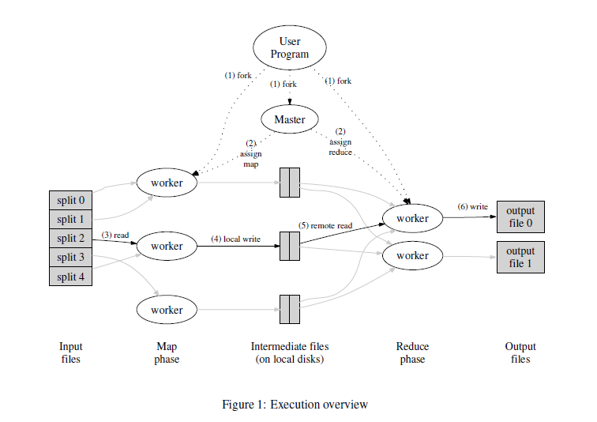
Distributed MapReduce
Google, Hadoop, etc…
Communication by message
Fault-tolerance important
Notes:
Most MapReduce usage is distributed, like Google search. Here communication is by messages, and fault-tolarnce is critical

Slide 57
Multicore MapReduce
Phoenix, Phoenix++, Metis …
Communication by shared memory objects
Fault-tolerance unimportant
Notes:
Here we have considered the less common use of MapReduce on multicore, where communication is by shared objects. Here fault-tolerance is not considered important

Slide 58
Costs
key-value layout
cache pressure
memory allocation
static vs dynamic
mechanism overhead

Slide 59

Part Two
Data Streams
Notes:
Java (starting from Java 8) provides explicit support for data-parallel computation through the Stream class (nothing to do with I/O).

Slide 60
Streams
source
sequence of
transformations
data
transformation
sometimes in parallel
data
no relation to
I/O streams
transformation
data
consumer
Notes:
Java (starting from Java 8) provides explicit support for data-parallel computation through the Stream class, which should not be confused with I/O streams, which are unrelated. Streams are not data structures: instead, they should be through of as pipelines that carry values from a source (often a container such as a \cList{}), though a series of transformations (perhaps applied in parallel), to a destination (also often a container).

Slide 61
Streams
source
data
transformation
data
transformation
data
transformations given by
mathematical functions
consumer
Notes:
Streams are never modified. Instead, one can apply transformations to streams to create new streams. The compiler and run-time are smart enough to make this efficient.

Slide 62
Streams
source
transformation creates
new stream
data
transformation
data
no modifications or side-effects
transformation
data
correctness easier?
consumer
Notes:
Creating new streams instead of modifying existing ones has several advantages: the behavior can be described cleanly, without the need for messy for-loops, index variables, and other clutter.

Slide 63
Functional Programming
functions map old state to new state
old state never changed
no complex side-effects
elegant, easier proofs of correctness
Notes:
This style of programming, where data structures are immutable, and computation takes place by (logically) creating new data structures, is called functonal programing.

Slide 64
Oh, Really?
“Functional languages are unnatural to use; but so are knives and forks, diplomatic protocols, double-entry bookkeeping, and a host of other things modern civilization has found useful.”
Jim Morris, 1982
Notes:
The idea of functional programming has been around for a long time. At first it was quite controversial, because while many people felt it was clean and elegant, many people thought it was to inefficient to be practical. Jim Morris was an early researcher on this topic.

Slide 65

Haiku
esthetically pleasing
only works on those who understand Haiku
Notes:
Morris observed that Haiku, a form of Japanese poetry, was elegant, but it can only be appreciated by others skilled in the art.

Slide 66

Karate
esthetically pleasing
works even on those who do not understand Karate
Notes:
By contrast, Karate, another Japanese art, can also be elegant, but it works even on those unskilled in the art, as in bar-fights.

Slide 67
Jim Morris’s Question
Is functional programming more like Haiku or Karate?
1981: Haiku
Today: Karate
Notes:
Morris claimed that the ultimate test of functional programming is whether it was more like Haiku or morelike Karate. Then, it was probably Haiku. Today, it’s Karate.

Slide 68
Laziness
1,2,3,…
No computation until absolutely necessary
add 1 to each element: no computation
x → x+1
double each element: no computation
x → 2x
∑ 2(x_{i}+1) is terminal
sum
Notes:
It is important to understand that Streams are lazy: they perform computation only when necessary. Here we have a sequence of transformations. When we add 1 to each stream element, no computation actually takes place: the operation is staged. When we double each element, that computation too is staged, but not executed. Only at the end, when we demand the sum, are the two transformations applied, and the sum computed. The sum is called a terminal operation.

Slide 69
Laziness
1,2,3,…
x → x+1
x → 2x
move to container is terminal
collect in List
Notes:
One common class of terminal operations is to collect the contents of a stream in a container

Slide 70
Laziness
1,2,3,…
x → x+1
x → 2(x+1)
x → 2x
Laziness permits optimizations
collect in List
Notes:
By accumulating operations, we give the compiler or run-time system a chance to optimize the sequence, perhaps by reordering or recombining operations

Slide 71
Laziness
Laziness permits infinite streams …
Stream<Integer> fib = new FibStream();
1
1
2
3
5
8
12
20
32
…
Notes:
Laziness permits us to define unbounded, or infinte streams, such as streams of Fibonacci numbers, or streams of random numbes.

Slide 72
Unbounded Random Stream
Stream<Double> randomDoubleStream() {
return Stream.generate(
() -> random.nextDouble()
);
}
Notes:
Here is how you would define an unbounded stream of random numbers.

Slide 73
Unbounded Random Stream
Stream<Double> randomDoubleStream() {
return Stream.generate(
() -> random.nextDouble()
);
}
Unbounded stream of double-precision random numbers
Notes:
Streams are typed by the types of their elements. Here, a stream of double-precision floats.

Slide 74
Random Stream
Stream<Double> randomDoubleStream() {
return Stream.generate(
() -> random.nextDouble()
);
}
Stream that generates new elements on the fly
Notes:
The generator constructor provides a function used to lazily create new elements.

Slide 75
Random Stream
Stream<Double> randomDoubleStream() {
return Stream.generate(
() -> random.nextDouble()
);
}
function to call when generating new element
example of Java lambda expression (anon method)
Notes:
This is the function: the parentheses mean it takes no elements, the arrow indicates the return value. This is an example of a lambda expression, a kind of anonymous function introduced in Java 8.

Slide 76
WordCount
List<String> readFile(String fileName) {
…
return reader
.lines()
.map(String::toLowerCase)
.flatMap(s ->
pattern.splitAsStream(s))
.collect(Collectors.toList());
}
Notes:
Let’s look at the same WordCount application, this time written in a functional style. First, let’s read in a document fragment from a file.

Slide 77
WordCount
List<String> readFile(String fileName) {
…
return reader
.lines()
.map(String::toLowerCase)
.flatMap(s ->
pattern.splitAsStream(s))
.collect(Collectors.toList());
}
puts each word from the document into a List
Notes:
First, we show you how to use a functional program to turn a file into a sequence of words

Slide 78
WordCount
List<String> readFile(String fileName) {
…
return reader
.lines()
.map(String::toLowerCase)
.flatMap(s ->
pattern.splitAsStream(s))
.collect(Collectors.toList());
}
open the file, create a FileReader
Notes:
This reader object is a Jave FileReader constructed by opening the file (not shown)

Slide 79
WordCount
List<String> readFile(String fileName) {
…
return reader
.lines()
.map(String::toLowerCase)
.flatMap(s ->
pattern.splitAsStream(s))
.collect(Collectors.toList());
}
how a stream program looks
each line creates a new stream
Notes:
a stream program usually consists of a single stream object concatenated with a sequence of stream operations. Good style to write like this.

Slide 80
WordCount
List<String> readFile(String fileName) {
…
return reader
.lines()
.map(String::toLowerCase)
.flatMap(s ->
pattern.splitAsStream(s))
.collect(Collectors.toList());
}
turn the FileReader into a stream of lines, each line a string
Notes:
First, we turn the FileReader into a stream of lines, each a string

Slide 81
WordCount
List<String> readFile(String fileName) {
…
return reader
.lines()
.map(String::toLowerCase)
.flatMap(s ->
pattern.splitAsStream(s))
.collect(Collectors.toList());
}
map creates a new stream by applying a function to each stream element
here, converts to lower case
Notes:
The map operation creates a new stream by applying a function to each element of a stream. Here, we convert each line into lower-case. Note that this is one line of code, not a big messy for loop.

Slide 82
WordCount
List<String> readFile(String fileName) {
…
return reader
.lines()
.map(String::toLowerCase)
.flatMap(s ->
pattern.splitAsStream(s))
.collect(Collectors.toList());
}
flatMap replaces one stream element with multiple stream elements
here, splits line into words
Notes:
Next, let’s split each line into individual words. The flatMap method replaces each string (line) with a sequenceof strings (words) but flattens the result into a longer sequence of strings. Writing this as a nested for loop would be complicated, but here it’s simple.

Slide 83
WordCount
List<String> readFile(String fileName) {
…
return reader
.lines()
.map(String::toLowerCase)
.flatMap(s ->
pattern.splitAsStream(s))
.collect(Collectors.toList());
}
collect puts stream elements in a container
here, in a List
terminal operation
Notes:
Next we collect the stream contents into a container (a List) to return from the call. The collect method that does this is complex, and we won’t try to explain it in detail.

Slide 84
WordCount
List<String> readFile(String fileName) {
…
return reader
.lines()
.map(String::toLowerCase)
.flatMap(s ->
pattern.splitAsStream(s))
.collect(Collectors.toList());
}
No loops
No conditionals
No mutable objects
Notes:
This program is simple when written in a stream-based style, but it would be long and complicated, but not in an interesting way, if we wrote it in a conventional style.

Slide 85
WordCount
Map<String,Long> map = text
.stream()
.collect(
Collectors.groupingBy(
Function.identity(),
Collectors.counting()));
now let’s count the words
Notes:
Now that we have put the words in a list, let’s count them

Slide 86
WordCount
Map<String,Long> map = text
.stream()
.collect(
Collectors.groupingBy(
Function.identity(),
Collectors.counting()));
start with list of words
Notes:
the text object is a List of words

Slide 87
WordCount
Map<String,Long> map = text
.stream()
.collect(
Collectors.groupingBy(
Function.identity(),
Collectors.counting()));
turn List into a stream
Notes:
we first convert it into a stream by calling the List class’s stream() method. Most containers provide such a method.

Slide 88
WordCount
Map<String,Long> map = text
.stream()
.collect(
Collectors.groupingBy(
Function.identity(),
Collectors.counting()));
put stream into a container (Map)
  word → count
Notes:
Next we will use collect() to convert the stream back to a map carrying each word to its count

Slide 89
WordCount
Map<String,Long> map = text
.stream()
.collect(
Collectors.groupingBy(
Function.identity(),
Collectors.counting()));
each element’s key is that element
Notes:
Each word is its own key (the built-in identify function just returns its argument)

Slide 90
WordCount
Map<String,Long> map = text
.stream()
.collect(
Collectors.groupingBy(
Function.identity(),
Collectors.counting()));
each element’s value is the number of times it appears
Notes:
The next call just counts all the elements that the identity function maps onto the same key, that is, it counts the number of times the word appears.

Slide 91
WordCount
Map<String,Long> map = text
.stream()
.collect(
Collectors.groupingBy(
Function.identity(),
Collectors.counting()));
No loops
No conditionals
No mutable objects
Notes:
As before, this program is remarkable for its simplicity, especially compared to the MapReduce vesion, or a conventional version using for loops.

Slide 92
k-Means
class Point {
Point(double x, double y) {…}
Point plus(Point other) {…}
Point scale(double x) {…}
static Point barycenter(
List<Point> cluster
) {…}
}
Notes:
Next we will do k-means in a functional style. This application is more complicated than WordCount, but it will be much simpler than the MapReduce version.

Slide 93
k-Means
class Point {
Point(double x, double y) {…}
Point plus(Point other) {…}
Point scale(double x) {…}
static Point barycenter(
List<Point> cluster
) {…}
}
stream-based!
Notes:
Next we will do k-means in a functional style. This application is more complicated than WordCount, but it will be much simpler than the MapReduce version.

Slide 94
BaryCenter
Notes:
You may remember from high-school geometry that the barycenter of a set of points is their center of mass

Slide 95
Stream Barycenter
Point barycenter(List<Point> cluster){
double numPoints = cluster.size();
Optional<Point> sum = cluster
.stream()
.reduce(Point::plus);
return sum.get()
.scale(1 / numPoints);
}
Notes:
First, let’s see how to use streams to compute the barycenter of a set of points

Slide 96
Stream Barycenter
Point barycenter(List<Point> cluster){
double numPoints = cluster.size();
Optional<Point> sum = cluster
.stream()
.reduce(Point::plus);
return sum.get()
.scale(1 / numPoints);
}
cluster size
Notes:
First we need to know how many points there are

Slide 97
Stream Barycenter
Point barycenter(List<Point> cluster){
double numPoints = cluster.size();
Optional<Point> sum = cluster
.stream()
.reduce(Point::plus);
return sum.get()
.scale(1 / numPoints);
}
turn List into Stream
Notes:
as usual, we turn the list into a stream so we can apply aggregate operations

Slide 98
Reduce
stream.reduce(+):
() → ;
(a) → a
(a,b) → a+b
(a,b,c) → (a+b)+c
terminal operation
etc. …
Notes:
The reduce() transformation is powerful. It takes an operation, in this case +, and links all the list elements with it. Reduce of an empty stream is nothing, reduce of a single-element stream is that element, and otherwise we add the elements (or apply whatever the operation argument is). Obviously, reduce is terminal.

Slide 99
k-Means
Optional because sum might be empty!
Point barycenter(List<Point> cluster){
double numPoints = cluster.size();
Optional<Point> sum = cluster
.stream()
.reduce(Point::plus);
return sum.get()
.scale(1 / numPoints);
}
sum points in cluster
Notes:
Here, we apply the Point class’s Plus operation, which is just vector addition. We get back an Optional object, which is either a number or an empty value.

Slide 100
k-Means
Point barycenter(List<Point> cluster){
double numPoints = cluster.size();
Optional<Point> sum = cluster
.stream()
.reduce(Point::plus);
return sum.get()
.scale(1 / numPoints);
}
extract sum and divide by # points
Notes:
For the result, we extract the sum using get(), and then scale the point by 1 over the number of points. The result is the barycenter, again without messy loops or accumulation variables.

Slide 101
k-Means
List<Point> points =
readFile("cluster.dat");
centers =
randomDistinctCenters(points);
double convergence = 1.0;
while (convergence > EPSILON) {
…
}
Notes:
Now that we know how to compute barycenters, let’s do k-means.

Slide 102
k-Means
List<Point> points =
readFile("cluster.dat");
centers =
randomDistinctCenters(points);
double convergence = 1.0;
while (convergence > EPSILON) {
…
}
read points from file
Notes:
First we read the points from a file into a list

Slide 103
k-Means
List<Point> points =
readFile("cluster.dat");
centers =
randomDistinctCenters(points);
double convergence = 1.0;
while (convergence > EPSILON) {
…
}
pick random centers
Notes:
we seed the computation by choosing random distinct centers, one for each of k clusters

Slide 104
k-Means
List<Point> points =
readFile("cluster.dat");
centers =
randomDistinctCenters(points);
double convergence = 1.0;
while (convergence > EPSILON) {
…
}
keep going until centers are stable
Notes:
We will continue to iterate until the clusters are stable

Slide 105
Compute New Clusters
while (convergence > EPSILON) {
Map<Integer,List<Point>> clusters
= points
.stream()
.collect(
Collectors.groupingBy(
p ->
closestCenter(centers, p)
)
);
}
turn list of points into a Stream
Notes:
as usual, we start by turning our list of points into a stream

Slide 106
Compute New Clusters
put each point in a map
  key is closest center
  value is list of points with that center
while (convergence > EPSILON) {
Map<Integer,List<Point>> clusters
= points
.stream()
.collect(
Collectors.groupingBy(
p ->
closestCenter(centers, p)
)
);
}
Notes:
we use collect() to put the stream in a container. Here we provide a lambda that says each point should go into a list of points with the same closest center, that center is the key, and that list is the value.

Slide 107
k-Means Con’t
while (convergence > EPSILON) {
...
Map<Integer, Point> newCenters
= clusters
.entrySet()
.stream()
.collect(
Collectors.toMap(
e -> e.getKey(),
e -> Point.barycenter(e.getValue())
)
);
convergence = distance(centers, newCenters);
centers = newCenters;
}
compute new centers
map: ID → center
Notes:
Once the points are clustered, we must compute the new centers, represented here as a map carrying each cluster ID to its center

Slide 108
k-Means Con’t
while (convergence > EPSILON) {
...
Map<Integer, Point> newCenters
= clusters
.entrySet()
.stream()
.collect(
Collectors.toMap(
e -> e.getKey(),
e -> Point.barycenter(e.getValue())
)
);
convergence = distance(centers, newCenters);
centers = newCenters;
}
turn map into a Stream of
  (ID, point) pairs
Notes:
First, we turn the map into a stream of entries, key-value pairs, where the key is the cluster ID and the point is the value

Slide 109
k-Means Con’t
while (convergence > EPSILON) {
...
Map<Integer, Point> newCenters
= clusters
.entrySet()
.stream()
.collect(
Collectors.toMap(
e -> e.getKey(),
e -> Point.barycenter(e.getValue())
)
);
convergence = distance(centers, newCenters);
centers = newCenters;
}
turn stream into a map
  ID → barycenter
Notes:
then we turn the stream back into map carrying each cluster ID to the barycenter of its associated points, using the barycenter method described earlier

Slide 110
k-Means Con’t
while (convergence > EPSILON) {
...
Map<Integer, Point> newCenters
= clusters
.entrySet()
.stream()
.collect(
Collectors.toMap(
e -> e.getKey(),
e -> Point.barycenter(e.getValue())
)
);
convergence = distance(centers, newCenters);
centers = newCenters;
}
new Key is still the cluster ID

Slide 111
k-Means Con’t
while (convergence > EPSILON) {
...
Map<Integer, Point> newCenters
= clusters
.entrySet()
.stream()
.collect(
Collectors.toMap(
e -> e.getKey(),
e -> Point.barycenter(e.getValue())
)
);
convergence = distance(centers, newCenters);
centers = newCenters;
}
new value is the barycenter computed earlier

Slide 112
k-Means Con’t
while (convergence > EPSILON) {
...
Map<Integer, Point> newCenters
= clusters
.entrySet()
.stream()
.collect(
Collectors.toMap(
e -> e.getKey(),
e -> Point.barycenter(e.getValue())
)
);
convergence = distance(centers, newCenters);
centers = newCenters;
}
If centers have moved, start again with the new centers
Notes:
Finally, we check the max distance between the newly-computed centers and the earlier set of centers. If the centers have not moved much, we are done, and otherwise we start again with the new clusters.

Slide 113
Functional k-Means
many fewer lines of code
easier to read (really!)
easier to reason
easier to optimize

Slide 114
Parallelism?
Arrays.asList("Arlington",
"Berkeley",
"Clarendon",
"Dartmouth",
"Exeter")
.stream()
.forEach(s -> printf("%s\n", s));
So far, Streams are sequential
Notes:
So far, the streams we have considered are sequential: all operations are applied sequentially.

Slide 115
Parallelism?
Arrays.asList("Arlington",
"Berkeley",
"Clarendon",
"Dartmouth",
"Exeter")
.stream()
.forEach(s -> printf("%s\n", s));
make List of strings and turn them into a stream
Notes:
To illustrate this, here is a stream of Boston street names

Slide 116
Parallelism?
Arrays.asList("Arlington",
"Berkeley",
"Clarendon",
"Dartmouth",
"Exeter")
.stream()
.forEach(s -> printf("%s\n", s));
forEach applies a method to each element (not functional)
Notes:
a stream program usually consists of a single stream object concatenated with a sequence of stream operations. Good style to write like this.

Slide 117
Parallelism?
Arrays.asList("Arlington",
"Berkeley",
"Clarendon",
"Dartmouth",
"Exeter")
.stream()
.forEach(s -> printf("%s\n", s));
prints
Arlington
Berkeley
Clarendon
Dartmouth
Exeter
Notes:
Every time we run this program, it prints the strings in the same order

Slide 118
Parallelism?
Arrays.asList("Arlington",
"Berkeley",
"Clarendon",
"Dartmouth",
"Exeter")
.parallelStream()
.forEach(s -> printf("%s\n", s));
turn List into a parallel stream
Notes:
suppose instead we turn the list into a parallel stream

Slide 119
Parallelism?
Arrays.asList("Arlington",
"Berkeley",
"Clarendon",
"Dartmouth",
"Exeter")
.parallelStream()
.forEach(s -> printf("%s\n", s));
prints
Dartmouth
Berkeley
Exeter
Arlington
Clarendon
Arlington
Berkeley
Clarendon
Dartmouth
Exeter
Dartmouth
Arlington
Clarendon
Berkeley
Exeter
Notes:
then every time we run the program, the strings appear in a different order, because they are printed in parallel

Slide 120
Parallelism?
Arrays.asList("Arlington",
"Berkeley",
"Clarendon",
"Dartmouth",
"Exeter")
.stream()
.parallel()
.forEach(s -> printf("%s\n", s));
can turn stream into a parallel stream
Notes:
another way to do this is to take a sequential stream and turn it into a parallel stream

Slide 121
Pitfalls
list.stream().forEach(
s -> list.add(0)
);
Notes:
Parallel streams have dangers. For example, here we are modifying the container that acts as the stream’s source

Slide 122
Pitfalls
list.stream().forEach(
s -> list.add(0)
);
lambda (function) must not modify source!
Notes:
do not do this

Slide 123
Pitfalls
source.parallelStream()
.forEach(
s -> target.add(s));
exception if target not thread-safe
order added is non-deterministic
Notes:
Another problem occurs when lambda’s have side effects: here we are adding elements in parallel to a container, which may not be thread-safe. Even if it is, the order is non-deterministic.

Slide 124
Conclusions
Streams support
functional programming
data parallelism
compiler optimizations

Slide 125
This work is licensed under a Creative Commons Attribution-ShareAlike 2.5 License.
You are free:
  to Share — to copy, distribute and transmit the work
  to Remix — to adapt the work
Under the following conditions:
  Attribution. You must attribute the work to “The Art of Multiprocessor Programming” (but not in any way that suggests that the authors endorse you or your use of the work).
  Share Alike. If you alter, transform, or build upon this work, you may distribute the resulting work only under the same, similar or a compatible license.
For any reuse or distribution, you must make clear to others the license terms of this work. The best way to do this is with a link to
  http://creativecommons.org/licenses/by-sa/3.0/.
Any of the above conditions can be waived if you get permission from the copyright holder.
Nothing in this license impairs or restricts the author's moral rights.

